Slide 1


Contact Angle prediction by Machine Learning
Name: Jiaqi Zheng
Mar.21
Notes:
亮亮图文旗舰店https://liangliangtuwen.tmall.com

Slide 2

Procedure
Contact Angle prediction
Build the database
Find a useful model to train and test the data
Improve the performance of the model
Change the parameters
Optimize the data
Combine several models together

Slide 3
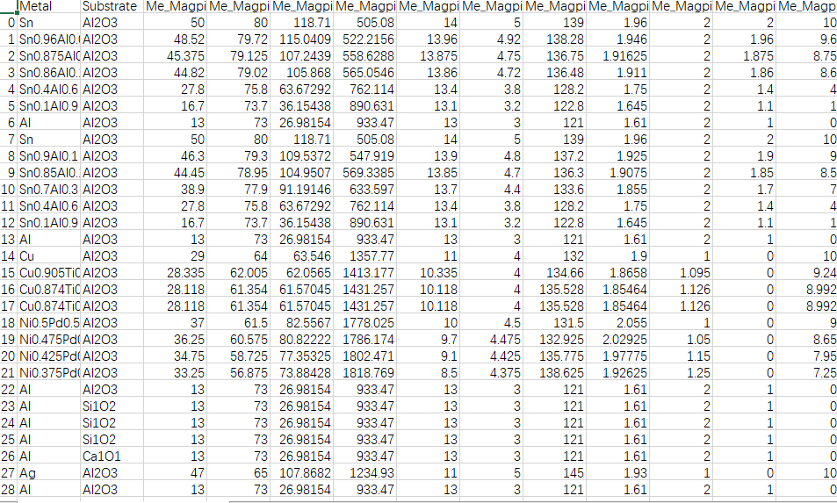

Database
About 1000 data with their properties, experimental temperature and contact angle are also included
80% for train
20% for test

Slide 4
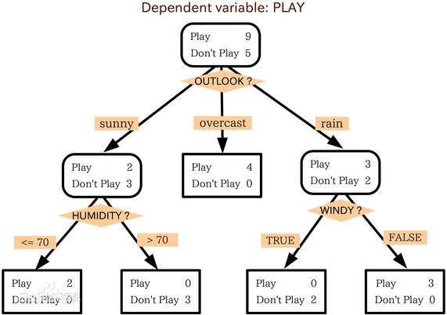
Model
Decision Tree
Choose the most important feature to classify, which means when a new data come in, it will get the highest accuracy

Slide 5

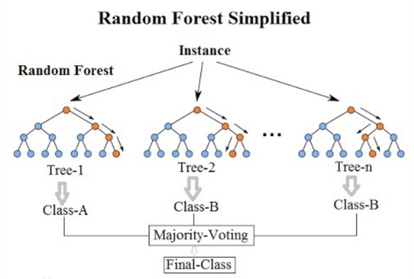
Model
Multiple Decision Tree
Random Sampling in one tree
Choose m features in M(all)

Slide 6

Model
make a better design tree ,how to find better feature that show great impact on result
Gini Impurity(Classification): Show the expected error rate when a data is put into the model, evaluate the level of disorder in database
Example:
A | 10
B | 10
I = 1- 0.5*0.5-0.5*0.5=0.5
A | 20
B | 0
A
I = 1- 1*1-0*0 = 0
∆=G(father)-G(child)=Gini(t)-pGini(tr)-(1-p)Gini(tl)
B
C

Slide 7

Model
Entropy(Classification): Refers to the measure or content of information required to select an event from N equal possible events
A | 10
B | 10
Example:
H = -0.5log(0.5)-0.5log(0.5)=log2
A | 20
B | 0
H = -log1 = 0
A
so for information gain
∆=entropy(father_node)-entropy(children_node)
B
C

Slide 8
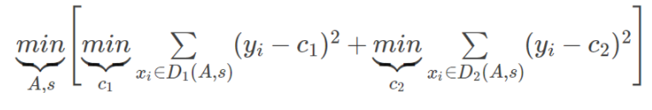
Model
Mean-Square Error(Regression):
C1 means the average value in dataset C1
C2 means the average value in dataset C2

Slide 9
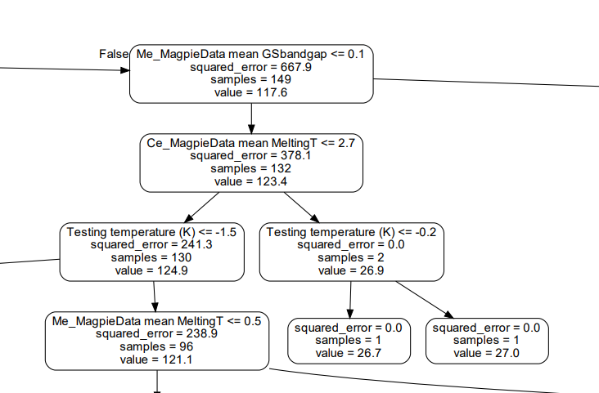
results
Tree Map

Slide 10
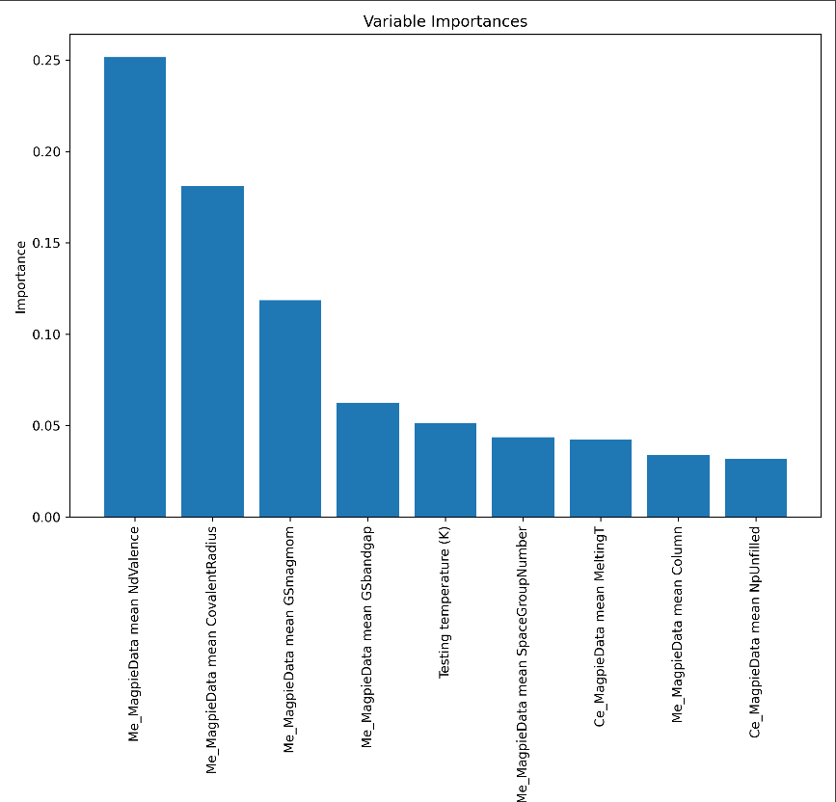
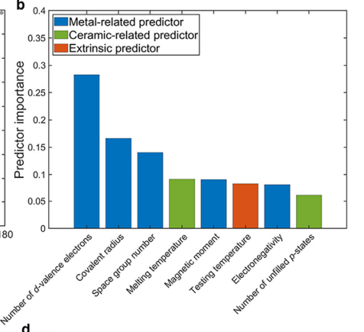
results
Variable Importance Map

Slide 11
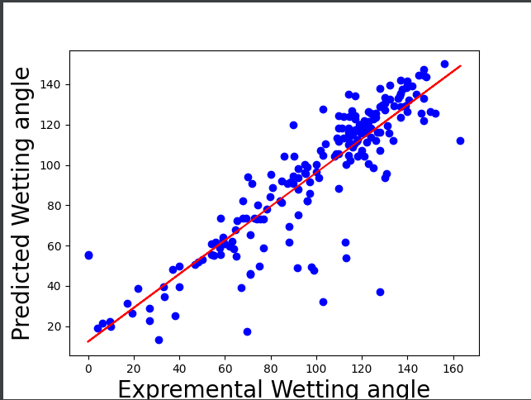

results
Accuracy Scores
Random forest 0.759261
Decision tree 0.715326
Linear Regression -0.085594
Equation:
Those y means predict value, real value and average value
Compare the model with average value prediction, which means R2>0, better than average value prediction, R2=1 means no errors,R2<0 bad than average value
y_test and y_pred by Random forest tree

Slide 12
THANK YOU FOR WATCHING

